Slide 1






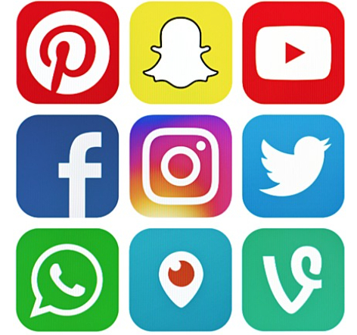

The Social Media Effect
Analyzing Impacts on Mental Health

Slide 2

Introduction
Social media sites like Instagram, Twitter, and Snapchat are essential to our everyday lives, especially among younger people.
These platforms provide unique opportunities for connection and expression.
Their rapid growth raises concerns about mental health.
Understanding social media's subtle impact.
Create tailored measures to improve digital wellbeing and reduce the risks of prolonged use.

Slide 3

Methods and Data Collection
Data Sources : Together core and supplemental databases give valuable information on social media usage and mental health markers.
We collected primary data using Qualtrics questionnaires, including age, occupation, social media interests, and Likert scale questions. Also used Dataset from Kaggle.
Link for the Qualtrics Survey - https://clarku.qualtrics.com/jfe/form/SV_9YuMtOKL7RCrd8a

Slide 4
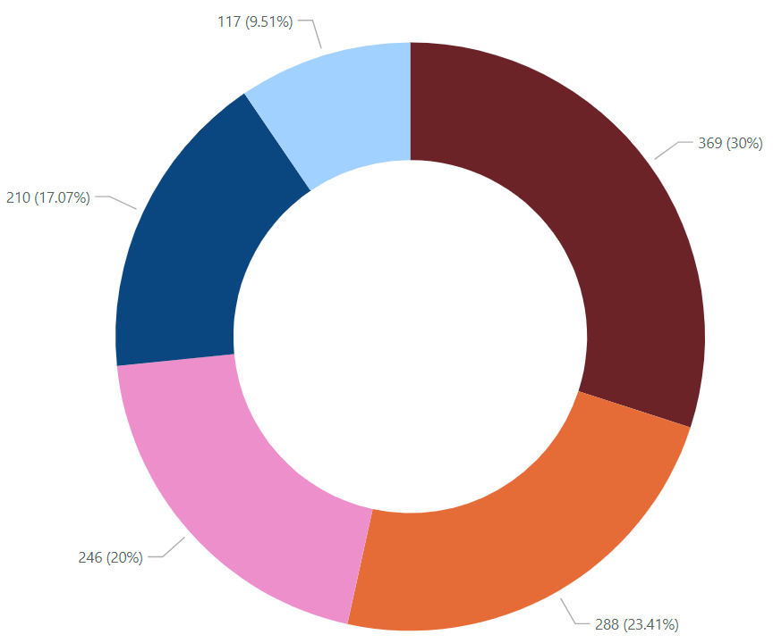
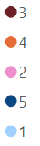
Analysis 1 : Restleness when you havent use Social Media in a while
Not using social media for a very long time.
(30%) "not using social media for a very long time
(23.41%)"haven't used social media for a while.
( 17.07%) social media in the last day
(20%)Used social media frequently.
(9.51%)"Used social media frequently

Slide 5
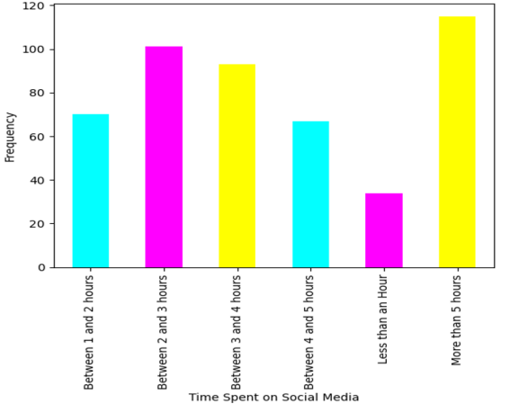
Analysis 2 : Time spent on social media
X-axis : Time Spent
Y-axis : Frequency of Population

Slide 6
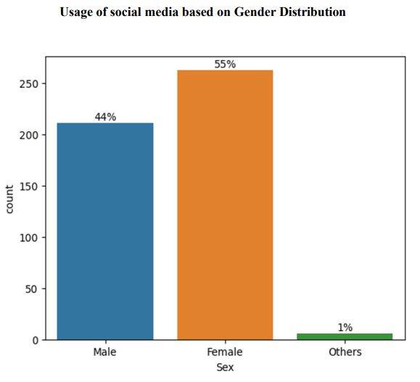
Analysis 3 : Usage of Social media on Gender Distribution.
X-axis denotes Genders
Y-axis denotes count

Slide 7
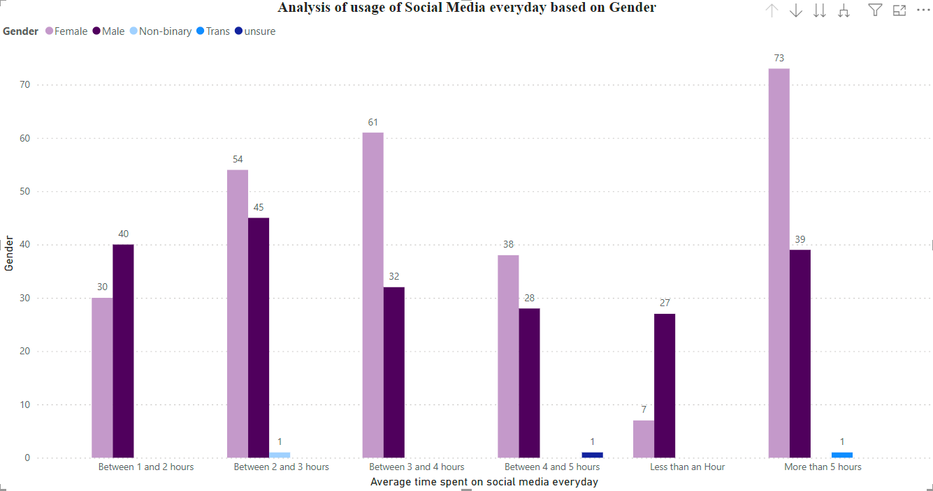
Analysis 4: Usage of Social media on everyday basis

Slide 8
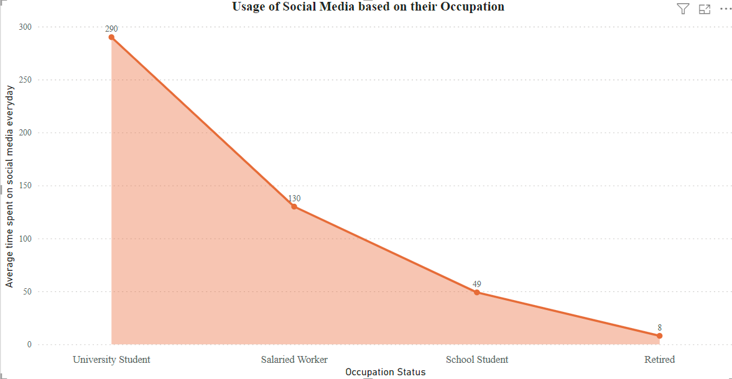
Analysis 5: Usage of Social media based on occupation.

Slide 9
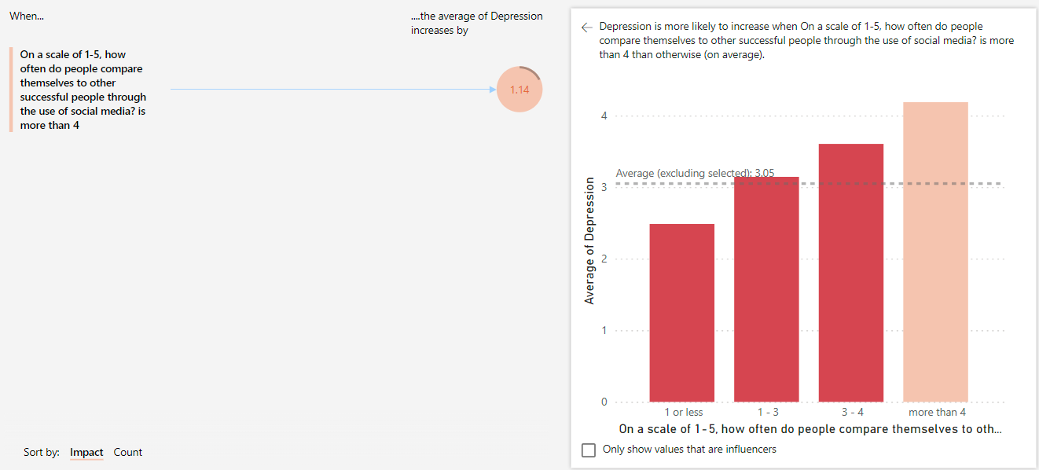
Analysis 6: Average of Depression
X-axis : comparison of their success according to social media.
Y-axis : Depression

Slide 10
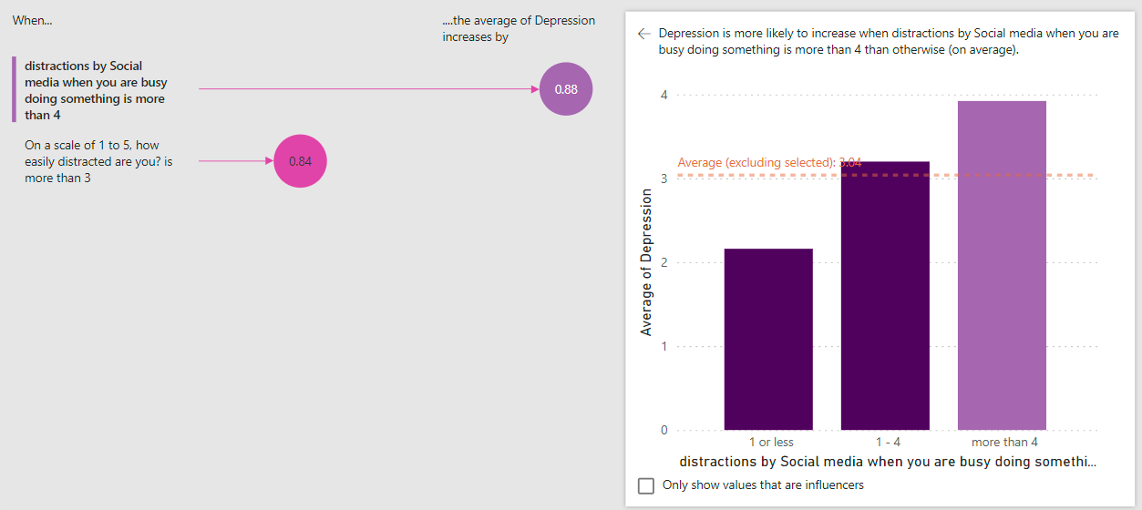
Analysis 7: Distraction by social media and Depression
X-axis : Distraction by social media while working
Y-axis : Depression

Slide 11
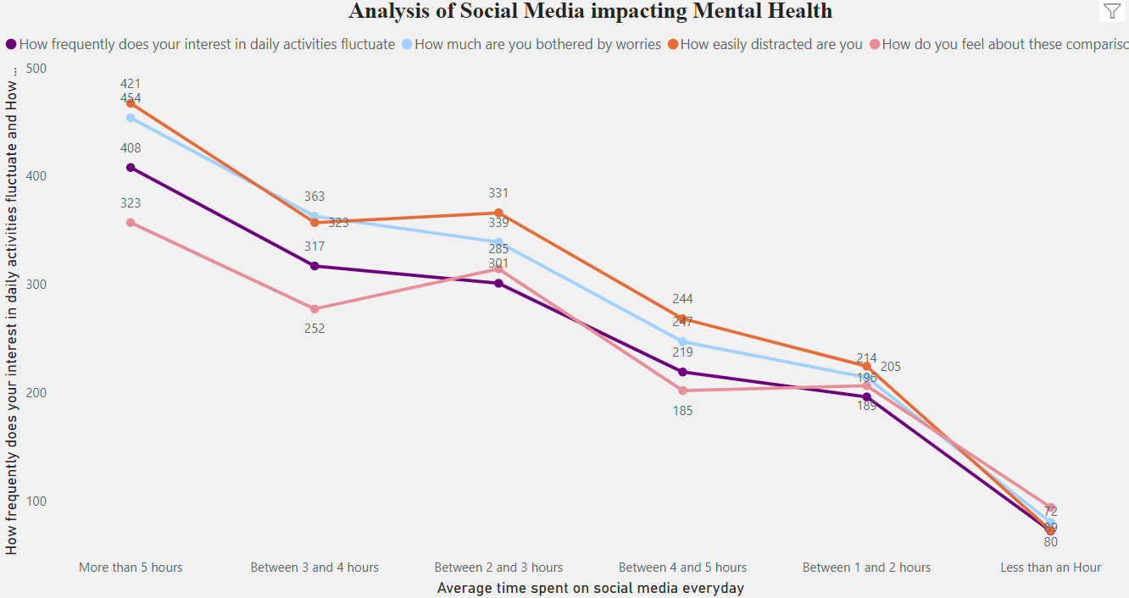
Analysis 8: Impact of Social media on Mental Health.

Slide 12
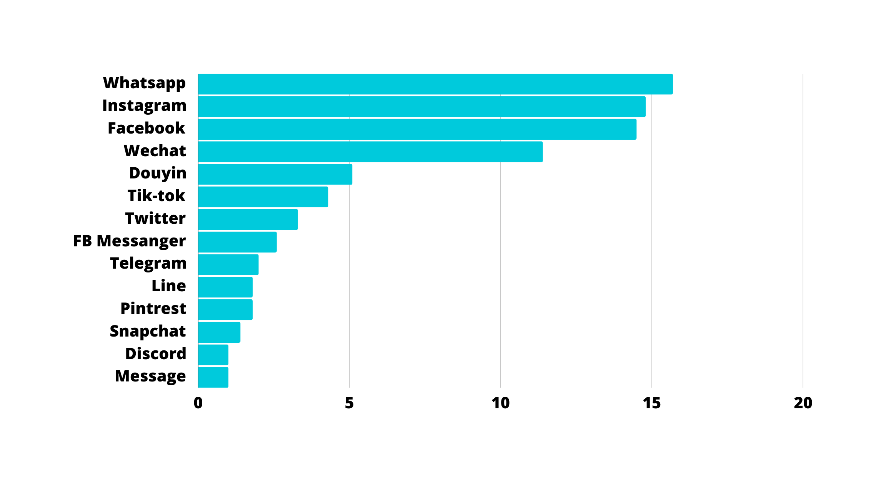
Analysis 9: Popular Social media platforms.

Slide 13
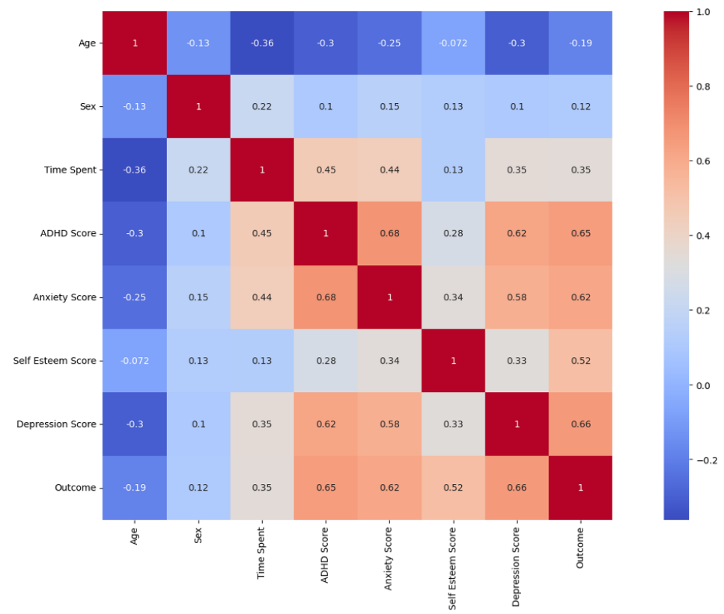
Correlation
ADHD scores and anxiety scores (0.68)
Time and Age (0.36 )
Depression Score and Outcome (0.66).
Scores for self-esteem and depression (-0.52).

Slide 14
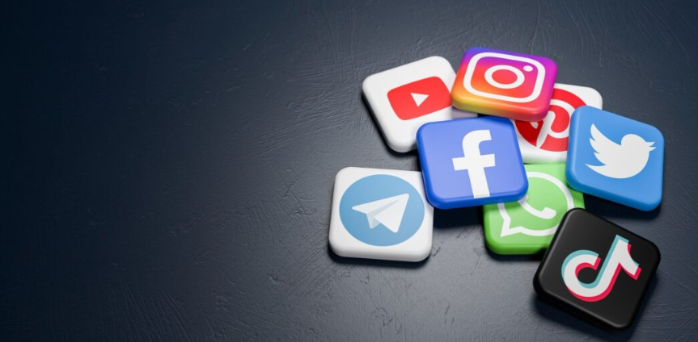
Practical Implications
01
02
03
Correlations with Mental Health Indicators
Impact of Popular Social Media Platforms
Implications for Investor Consideration

Slide 15




Educating and Raising Awareness
01
02
03
Risks of Excessive Social Media Use
Importance of Education and Awareness
Importance of Education and Awareness

Slide 16


Conclusion
Measures of the Success of Strategies
Obstacles That Were Encountered
Observations and Suggestions for Next Steps
The Effects on the Stakeholders:

Slide 17

Thank you!
Project by -
Anuja Bavkar
Vaibhavi Shastri
Sangram Dedge

